Slide 1

FACULTY OF INFORMATION TECHNOLOGY
Two-Factors Authentication System

Slide 2
Presented by :
Ahmed yousef
Omar Ayman
Abdelrahman Mohammed
Abdallah Safwat

Slide 3
Supervised by :
Dr. Alaa Zaghloul
TA. Eng. Islam Said
TA. Eng. Habiba Khaled

Slide 4

Agenda
Introduction
Possible Beneficiaries
Motivation
Main Objectives
SDG’s Goal
Related Works
Problem Definition
Proposed System
System Architecture
Methodologies and Techniques
System Requirements (S/W and H/W Tools)
Results and Outcomes
System Validation
Conclusion
References

Slide 5
Intoduction
Two-factor authentication (2FA) is a security system that requires two separate, distinct forms of identification in order to access something. The first factor is a password and the second commonly includes a text with a code sent to your smartphone, or biometrics using your fingerprint, face, or retina.
2FA is an identity verification method that requires a user to provide a second authentication factor in addition to a password or two authentication factors instead of a password in order to access a web site, application or network. Because it takes more work to hack a second authentication factor, and because other types of factors are more difficult to steal or falsify, 2FA improves account security and better protects an organization and its users from unauthorized access

Slide 6
Possible Beneficiaries
Businesses use 2FA to help protect their employees’ personal and business assets1. This is important because it prevents cybercriminals from stealing, destroying, or accessing your internal data records for their own use1. The advantages of 2FA are endless.
Two-factor authentication can be used to strengthen the security of an online account, a smartphone, or even a door.

Slide 7
Motivation
The motivation behind the 2FA system is to provide an additional layer of security to protect user’s credentials and the resources they can access. 2FA is implemented to better protect both a user’s credentials and the resources the user can access. It is a vital security tool for organizations to protect their data and users in the face of a cybersecurity landscape laden with a higher volume of increasingly sophisticated cyberattacks.
This is important because it prevents cybercriminals from stealing, destroying, or accessing your internal data records for their own use. The advantages of 2FA are endless

Slide 8
OBJECTIVES
Enhancing the security of online accounts.
Reducing the risk of data breaches.
Improving user confidence.
Complying with regulations.
Providing a seamless user experience
Supporting different authentication methods
Monitoring and reporting

Slide 9
Related Works
GOOGLE AUTHENTICATOR:
Google Authenticator is an app that generates verification codes for 2-Step Verification. It adds an extra layer of security to your online accounts by adding a second step of verification when you sign in.
This means that in addition to your password, you’ll also need to enter a code that is generated by the Google Authenticator app on your phone.
The verification code can be generated by the Google Authenticator app on your phone, even if you don’t have a network or cellular connection

Slide 10
Related Works
MICROSOFT AUTHENTICATOR:
Microsoft Authenticator is an app that provides multi-factor authentication (MFA) for Microsoft accounts and other services It allows users to sign in to their accounts using their fingerprint, face recognition, or a PIN instead of a password.
The app can also generate time-based one-time passcodes for use with other services that support authenticator apps.
Microsoft Authenticator is available for download on Android and iOS devices

Slide 11
Related Works
LASTPASS AUTHENTICATOR:
LastPass Authenticator is an app that offers effortless two-factor authentication for your LastPass account and other supported apps. With one-tap verification and secure cloud backup, LastPass Authenticator gives you all the security, without any of the frustration.
It adds an essential layer of security to keep hackers out, is quick to set up, easy to use, facilitates rapid logins, and creates a roadblock for bad actors without making it harder for you to log in

Slide 12
Problem Definition
With the growing number of data breaches and cyber attacks, user accounts are becoming increasingly vulnerable to unauthorized access, Passwords can be easily compromised through various means such as phishing attacks, social engineering, and brute-force attacks.
2FA provides an additional layer of protection by requiring users to provide a second form of identification in addition to their password. This significantly reduces the risk of account compromise, as an attacker would need to have access to both the password and the second factor (such as a smartphone or token) to gain access to the account.

Slide 13
Proposed System
BE SECURE WEBSITE:
It is a System that allows users to register and Login into the page.
The System uses two levels of protection:
text protection:
- by Entering a Username & Password.
OTP verefication code(optional) :
- by Entering the One-Time-based Password (OTP-code) .
The user can manage his personal account, add or renew information, or delete the account.

Slide 14
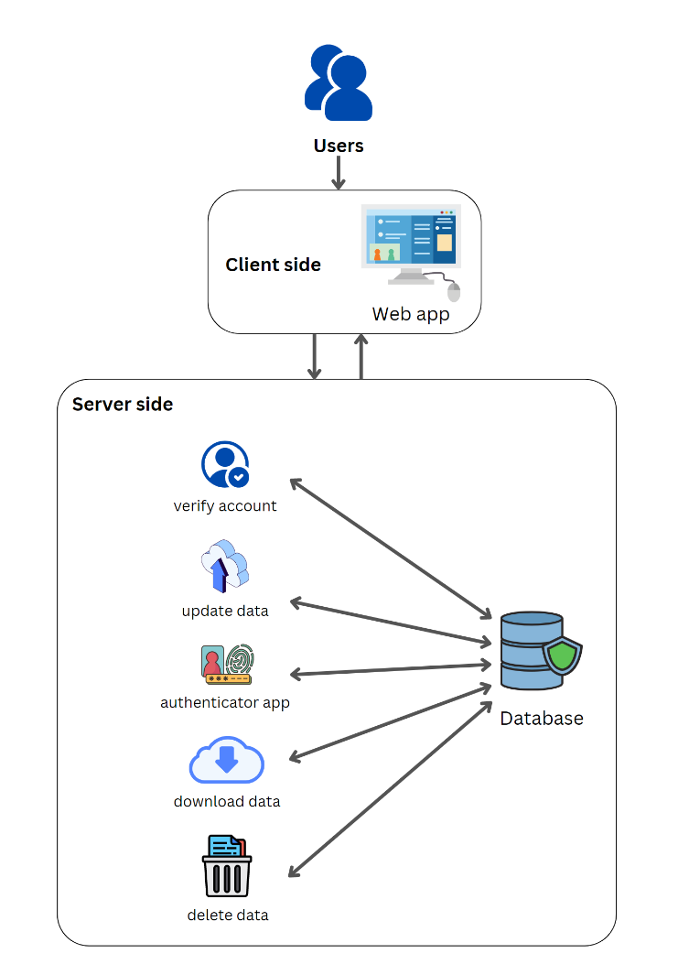
System Architecture

Slide 15
Methodologies and Techniques
Agile methodology.
Scrum Framework.
ASP.NET Core Identity farmework.
is an API that supports user interface (UI) login functionality and manages users, passwords, profile data, roles, claims, tokens, email confirmation, and more. Users can create an account with the login information stored in Identity or they can use an external login provider such as Facebook, Google, Microsoft Account, and Twitter. It is typically configured using a SQL Server database to store user names, passwords, and profile data

Slide 16
System Requirements (S/W and H/W Tools)
Hardware:
In general, this System require a device such as a smartphone or a hardware token to generate or receive the second authentication factor.
Software:
also require specific software to be installed on the user’s device, such as an authenticator app. For example, Google Authenticator and Microsoft Authenticator are apps that can be downloaded on Android and iOS devices

Slide 17
Results and Outcomes
organization's systems and data security is improved.
Full user account control.
user data is protected.
user experience Improved.
security is Increased.

Slide 18
System Validation
...

Slide 19
Conclusion
In conclusion, 2FA is a security system that provides an additional layer of protection for user credentials and the resources they can access. By requiring two separate, distinct forms of identification, 2FA makes it more difficult for unauthorized users to gain access to sensitive information.
2FA can be implemented using a variety of methods, including hardware tokens, authenticator apps, and biometric authentication. System validation is an important step in ensuring that a 2FA system is functioning correctly and providing the desired level of security.

Slide 20
References
"A Comparative Study of Two-Factor Authentication Methods for Mobile Devices" Authors: Muhammad Bilal Abbasi, Jafar Al-Gharaibeh, Yousef Kilani Published in: IEEE Access Year: 2020.
Article: "Two-Factor Authentication: A Comparative Study of Usability and Security" Authors: Vishal Saraswat, Pradeep Kumar Singh Published in: International Journal of Computer Science and Information Security (IJCSIS) Year: 2019.
Agrawal, Alok Sharma Published in: International Journal of Scientific Research in Computer Science, Engineering and Information Technology (IJSRCSEIT) Year: 2017.
https://www.microsoft.com/ar-ww/security/business/security-101/what-is-two-factor-authentication-2fa.
https://authy.com.
https://blog.lastpass.com/2022/05/how-to-use-lastpass-authenticator.
https://www.techtarget.com/searchsecurity/definition/two-factor-authentication.
https://www.fortinet.com/resources/cyberglossary/two-factor-authentication

Slide 21


